Slide 1
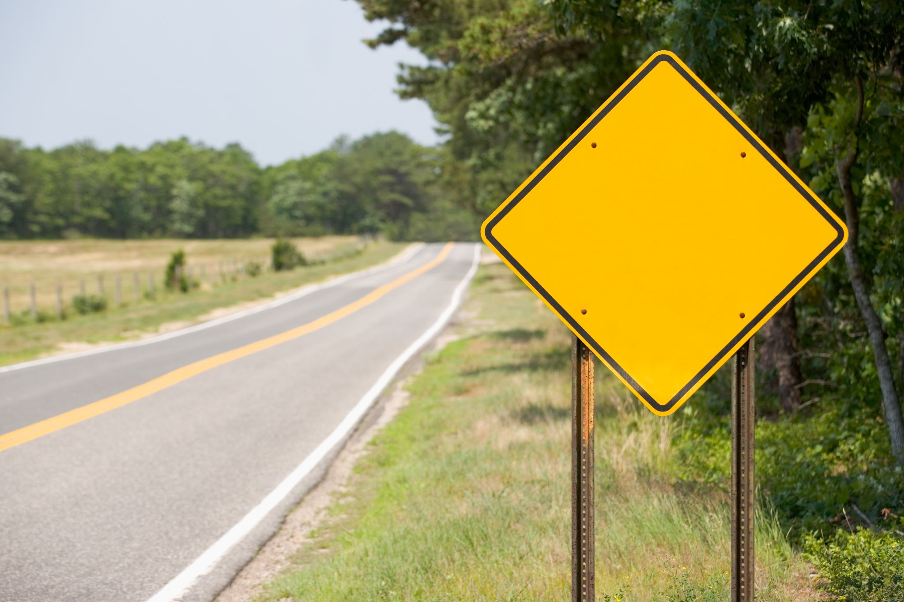
Traffic sign detection
Toma Sebastian-Antonio
Moraru Alex Mihai
Group 30431

Slide 2

Possible solutions flow

Slide 3
Segmentation of desired colors
Histogram equalization
Converting to HSV
Masking for red and blue channels
Augmenting the red and blue channels
Separate the three channels into gray images

Slide 4
Finding the region of interest
Aplpying opening on the separated images
MSER (Maximally Stable Extremal Regions) is a method used for blob detection in images and is widely used in traffic sign recognition pipeline.
Aspect Ratio check
Non-Maxima Supression

Slide 5
Finding the contour
Canny Edge Detection
Combined with MSER
Combined with checking the local maxima of the Histogram of Oriented Gradients

Slide 6
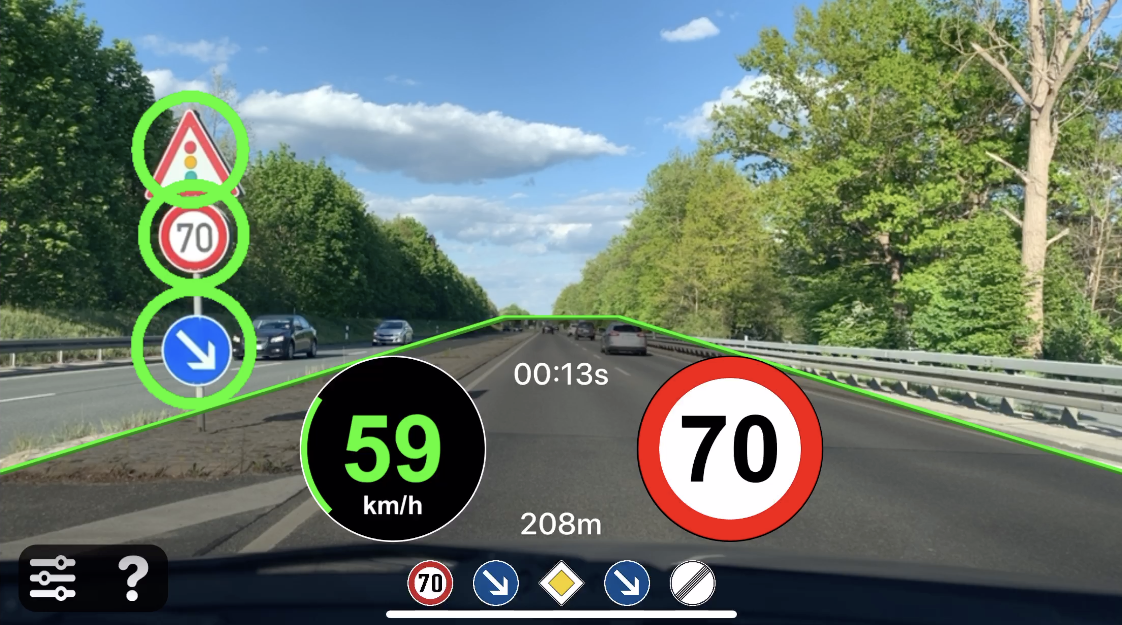
Getting the results
The identified signs could be outlined by a rectangle

Slide 7
Steps & implementation ideas

Slide 8
Implementation details
Implemented in C++ and OpenCV library

Slide 9
Histogram equalization
To remove too bright or too dark areas and also helps in cleaning out the image

Slide 10
Converting to HSV
We convert to HSV because HSV representation is better for segmentation and object detection
We define some thresholds to augment the blue and red areas
Evidentiate those areas in black and white images

Slide 11
Separate the three channels into gray images
To remove unwanted areas
We augment the blue and red channels and separate in 3 gray channels

Slide 12
MSER (Maximally Stable Extremal Regions)
To better get rid of unwanted areas
Implemented using cv::MSER

Slide 13
Erosion & dilation
The desired areas found by MSER are plotted using convex hulls
Then the regions are cleared using erosion and dilation

Slide 14
Finding the regions of interest
We select the biggest detected areas
We perform aspect ratio check on the remaining contours and compare them to predefined shapes

Slide 15
Finding the contour for the regions of interest
Canny edge detection to better see the edges
Histogram of oriented gradients
Getting the local maxima of the histogram to analyze the shape

Slide 16
Getting the results
As we keep the coordinates of the contour, in the end we can match the contour on the original image and highlight it using its shape (maybe with a small increase in its area for a better viewing)

Slide 17
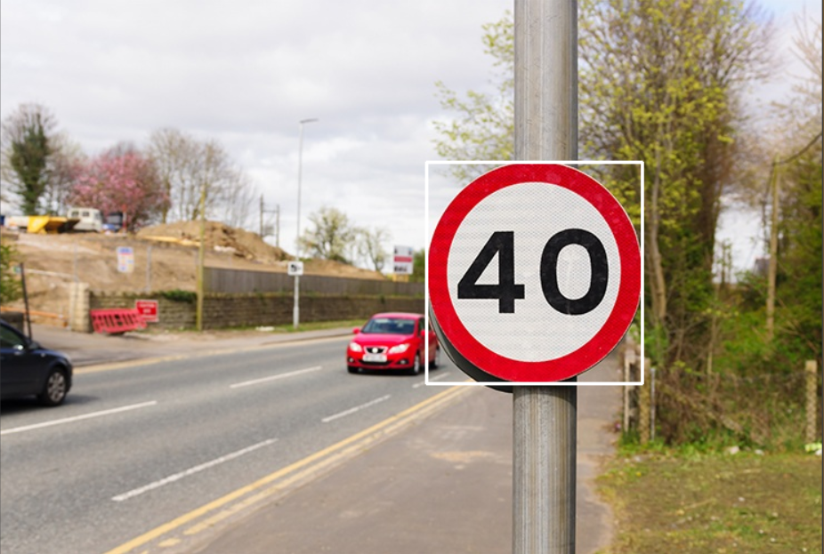
Results

Slide 18
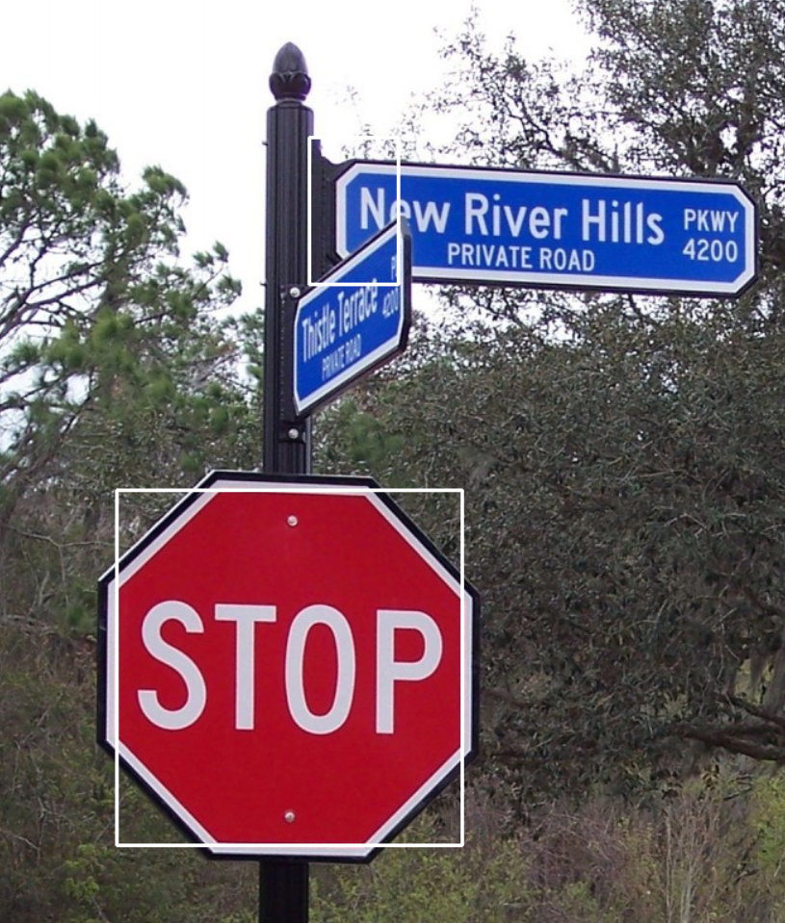
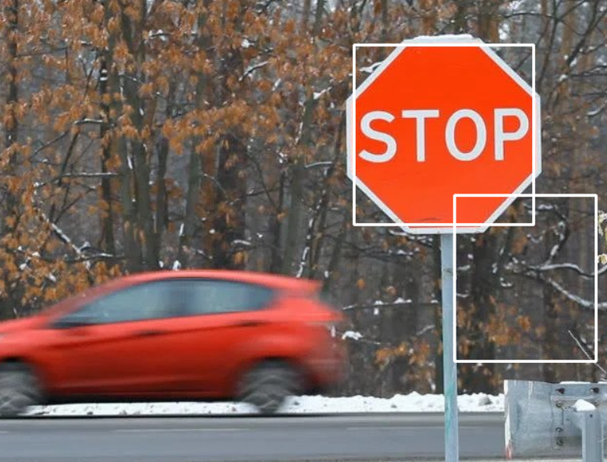

Slide 19
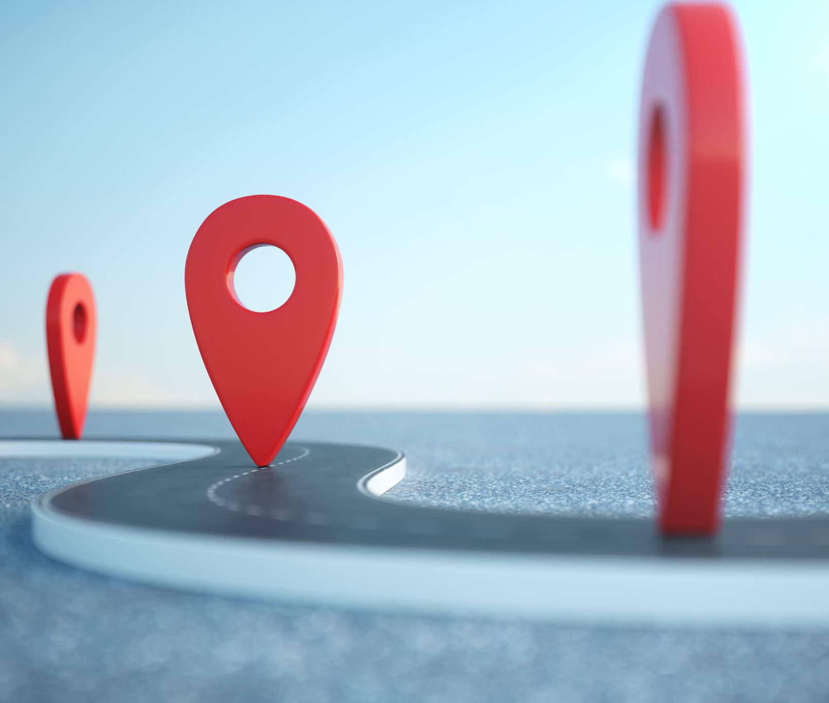
Related work on traffic sign detection
https://ieeexplore.ieee.org/abstract/document/7033810/metrics#metrics
https://github.com/hoanglehaithanh/Traffic-Sign-Detection
https://medium.com/lifeandtech/traffic-sign-detection-recognition-f6e741543619

